Slide 1

Leaders' School & College Chattogram
Class: VII (Bangla Version)
L#01
Topic Name: Introduction to Python Programming
Md. Amin Kaiser
B.Sc. in CSE, DUET
Assistant Teacher(ICT)
E-mail: aminkaiser90@gmail.com

Slide 2
Contents
What is Programming?
What is Programming Language?
Why We Choose Python?
Creating Environment
Your First Python Program
How to Run Your Program
A Simple Test!

Slide 3
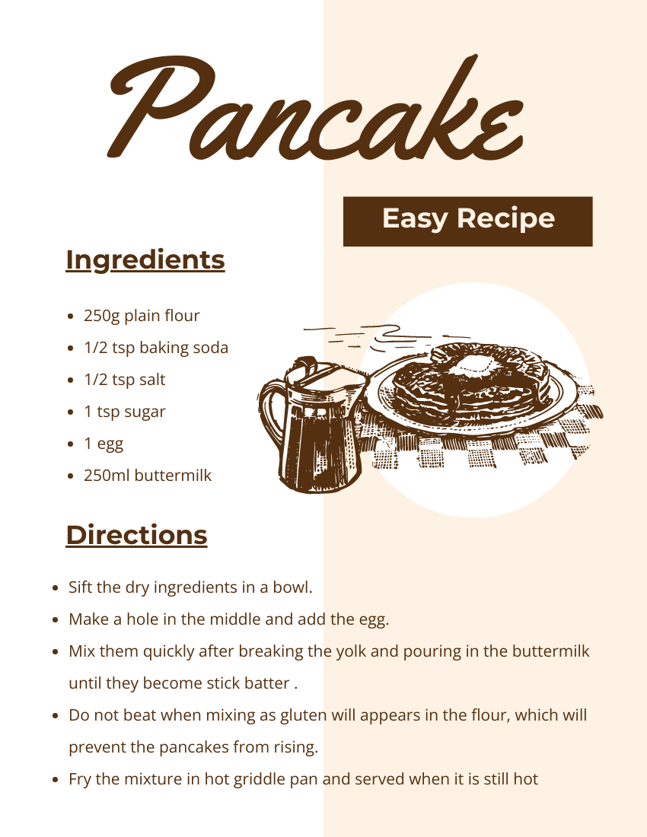
Have you Ever Made a Recipe?
We need to Follow some instructions!
Finally, we will be able to make a delicious item.

Slide 4

What is Programming?
Computer only understand 0 and 1
We need to give instructions to a computer on what to do
Program is a set of instructions to do a particular task

Slide 5

What is Programming Language?
We use language to communicate with each other
To communicate with computer: for giving instructions, we need to use a language
Python is one kind of Programming Language
C, C++, Java, C#, JavaScript etc.

Slide 6
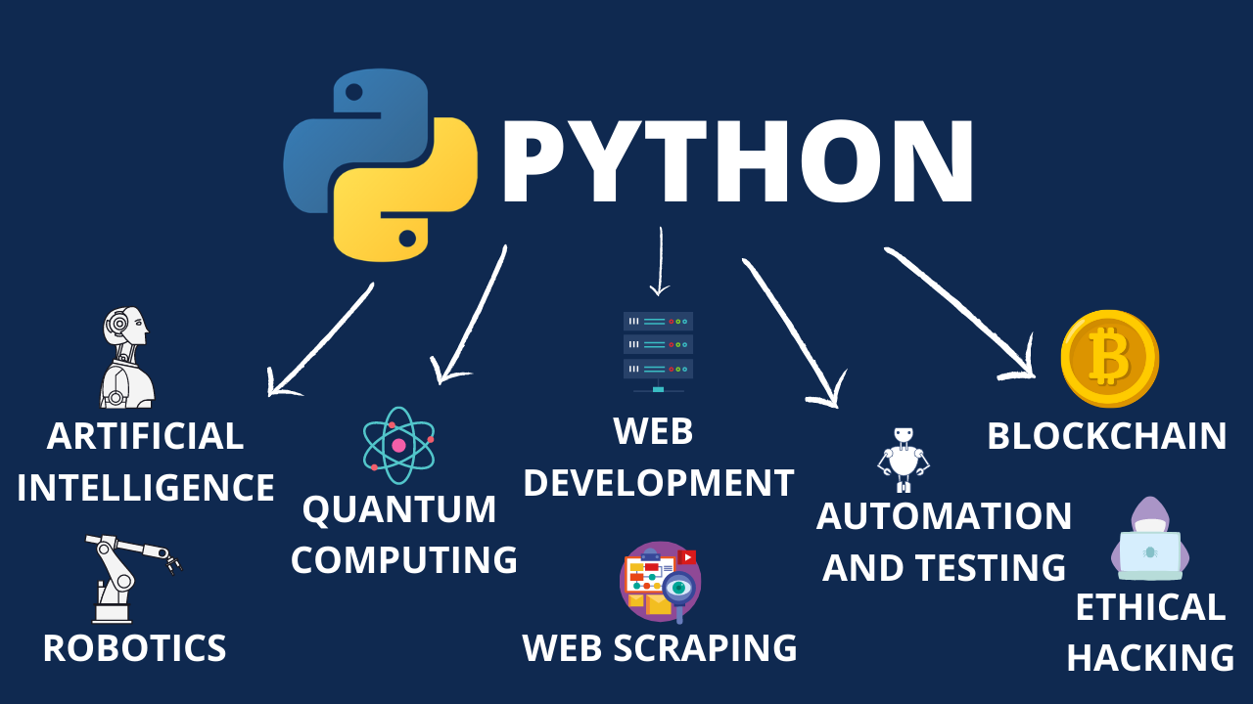
Why we choose Python?
Easy to learn and read
Versatile: Web Development, Data Analysis, Scientific Computing, Artificial Intelligence, Machine Learning, Automation

Slide 7
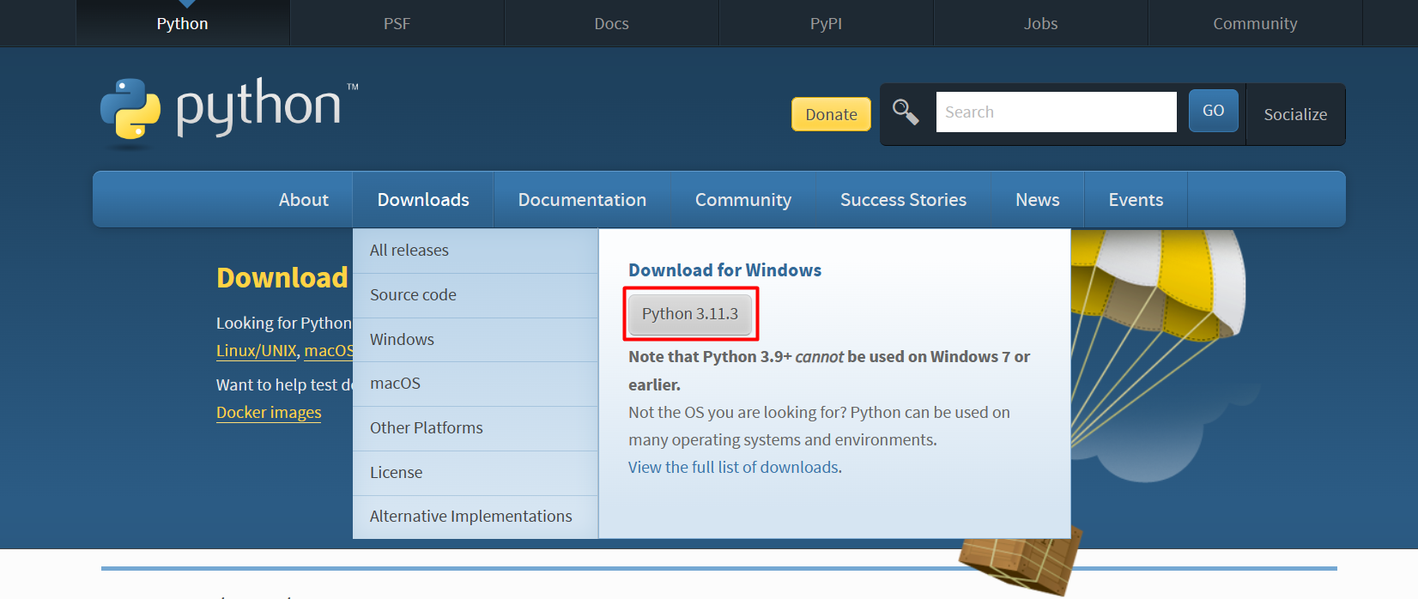
Creating Environment: Installing Python and PyCharm
To install Python: visit https://www.python.org/downloads/ -

Slide 8
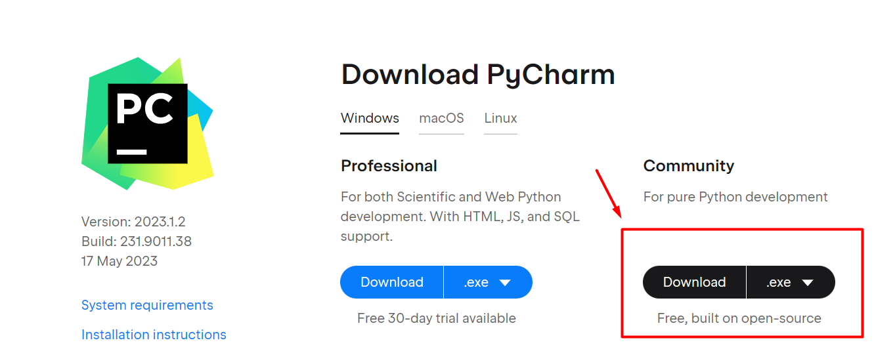
Creating Environment: Installing Python and PyCharm
To install PyCharm: visit https://www.jetbrains.com/pycharm/download/

Slide 9
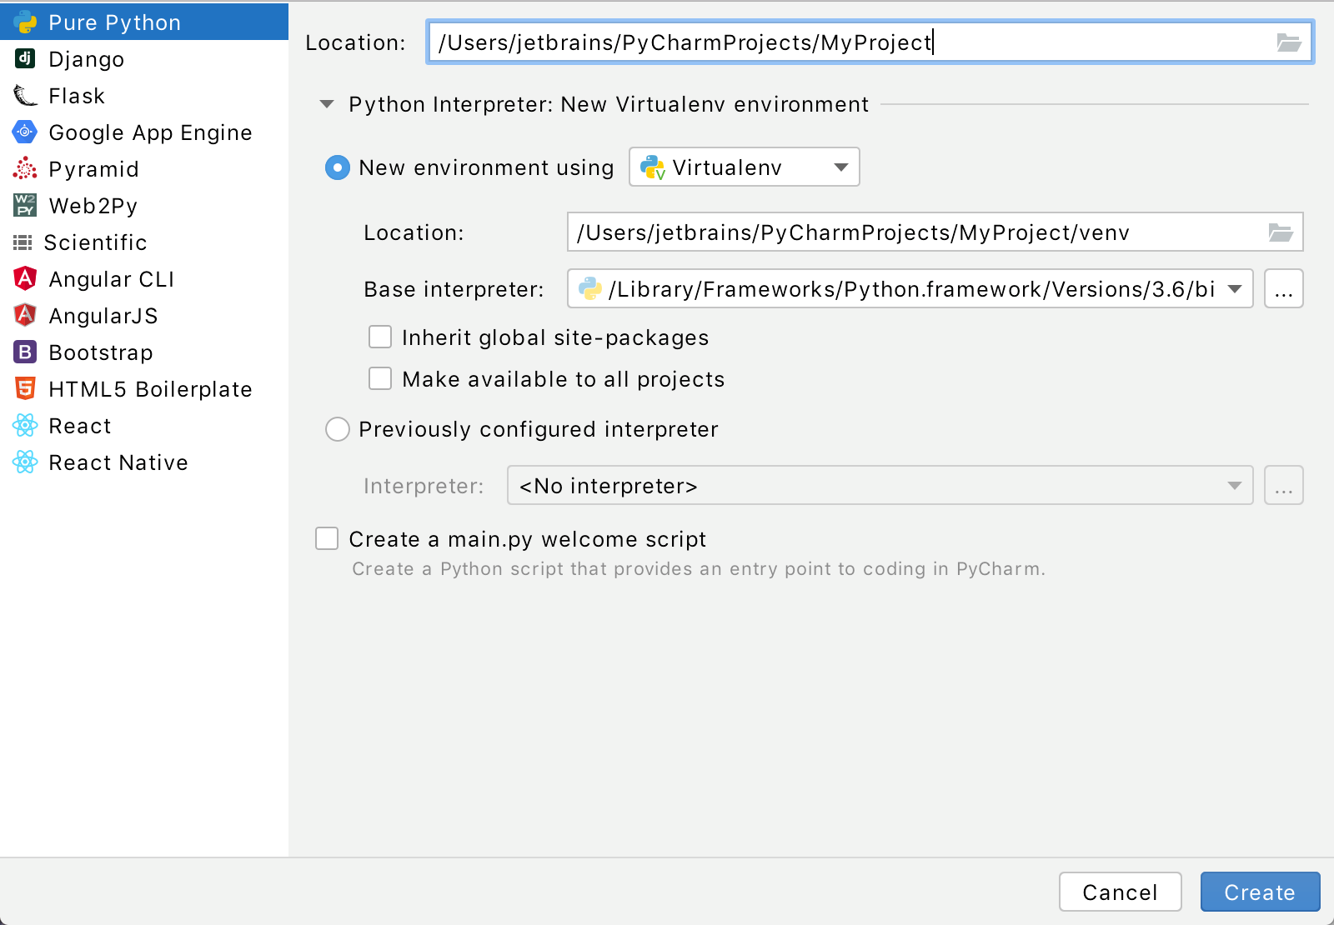
Creating Environment: Your First Python Project
If you’re on the Welcome screen, click New Project.
If you’ve already got any project open, choose File | New Project from the main menu.

Slide 10
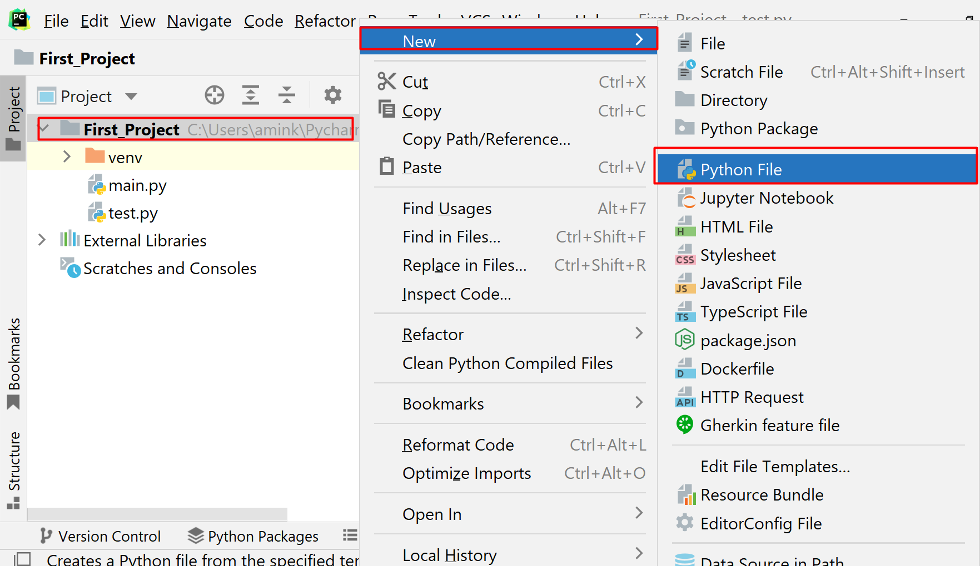
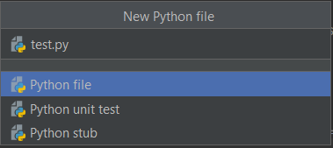
Creating Environment: Your First Python Project
In the Project tool window, select the project root (typically, it is the root node in the project tree), right-click it, and select File | New> Python File
Type a File name.py(test.py)

Slide 11
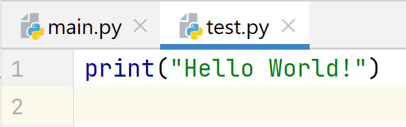
Your First Python Program: Print a Message!
print(“Your Message”)

Slide 12
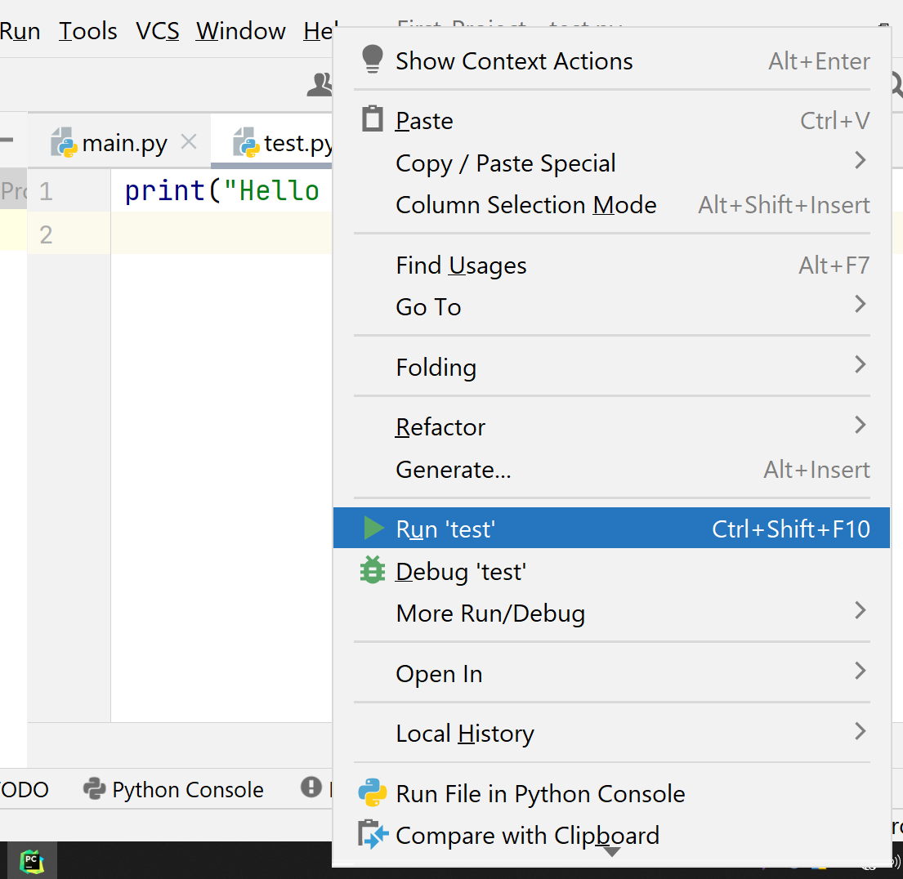
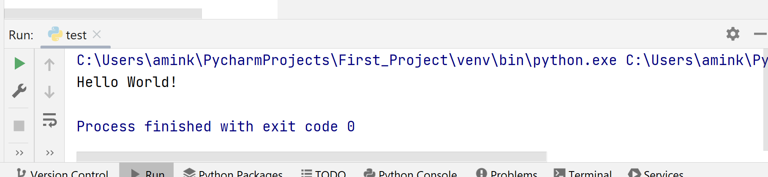
Run Your Program
Right-click the editor and select Run ‘test' from the context menu
Press Ctrl+Shift+F10
Since this Python script contains a main function, you can click an icon in the gutter.
Output:

Slide 13
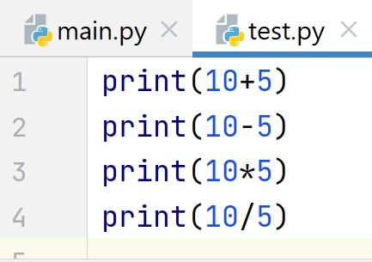
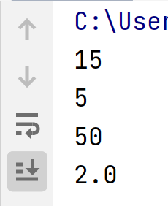
Mathematical Operations on print()
Output:

Slide 14
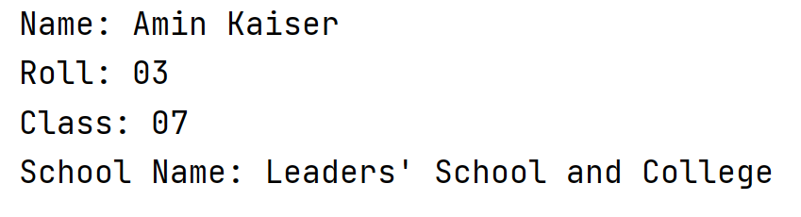
Test!
Print Your Name, Roll, Class, School Name on Output Screen

Slide 15
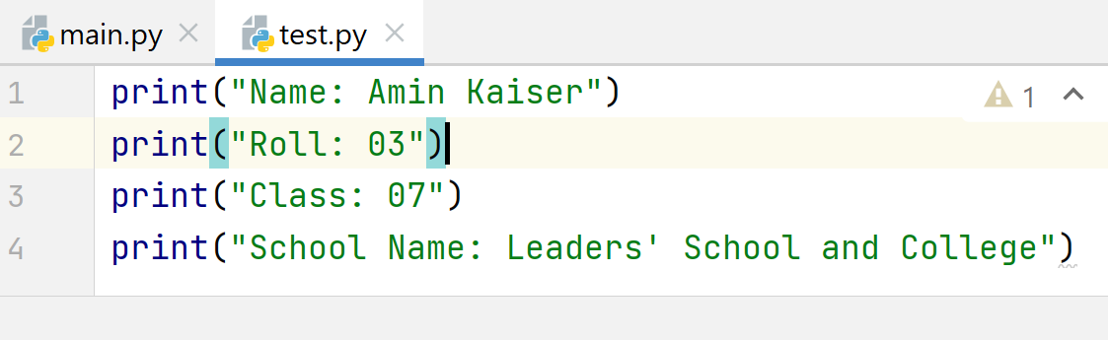
Solution!
Print Your Name, Roll, Class, School Name on Output Screen

Slide 16

Q/A Session

